Slide 1
July 06 2022, Data cleanup task
Problem | Name | Mitocondrial content | n_Counts | n_Genes | PC
1 | meethila | 20 | 1000 | 1000 | 20PC
2 | Graham | 20 | 500 | 500
3 | Mani | 20 | 0 | 0
4 | Ellen | 10 | 1000 | 1000
5 | Lucas | 10 | 500 | 500
6 | Shweta | 10 | 0 | 0
7 | Sierra | 0 | 1000 | 1000
8 |  | 0 | 500 | 500
9 | Cedomir | 0 | 0 | 0
10 | Jade | 20 | 1000 | 1000 | 100 PC
11 | Kaylee | 20 | 500 | 500
12 |  | 20 | 0 | 0
13 | Simon | 10 | 1000 | 1000
14 | Nicolai | 10 | 500 | 500
15 | Holly | 10 | 0 | 0
16 | Gautami | 0 | 1000 | 1000
17 | Sheed | 0 | 500 | 500
18 | Jared | 0 | 0 | 0

Slide 2
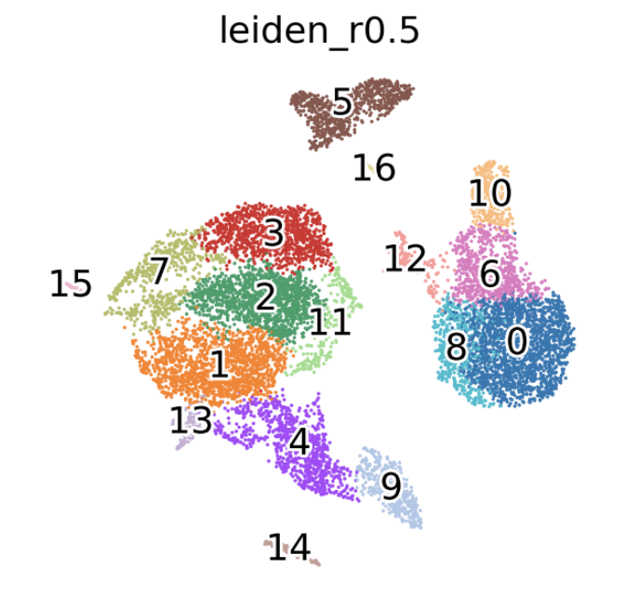
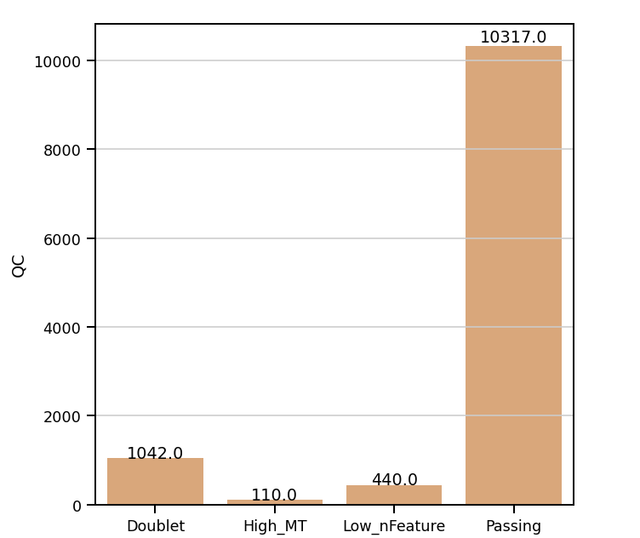
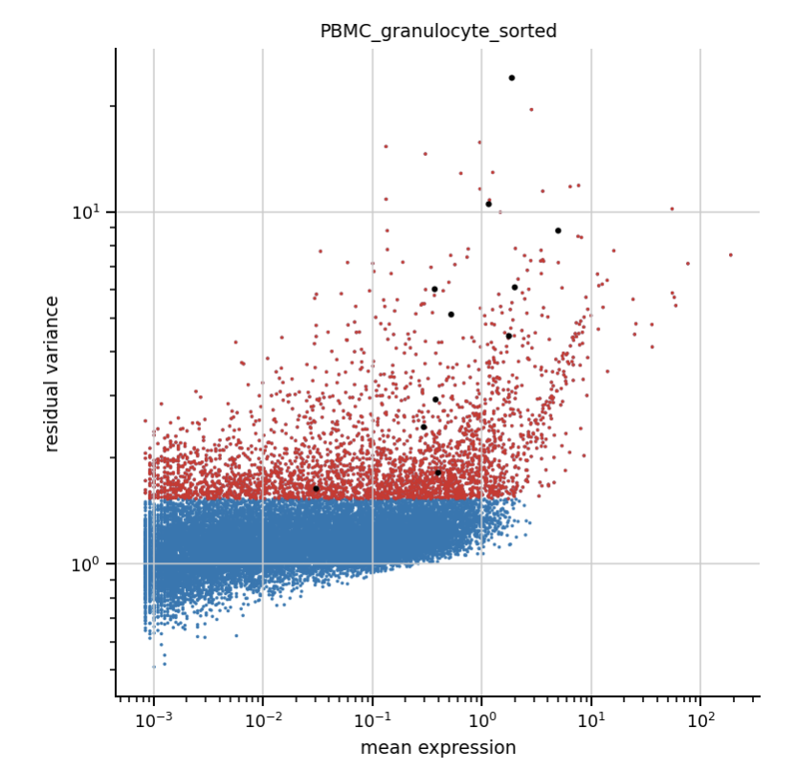
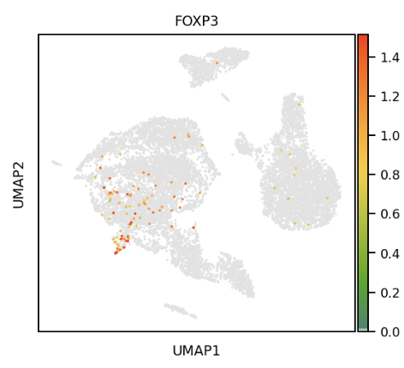
Problem 1: Meethila
Name | Mitocondrial content | n_Counts | n_Genes | nPC
meethila | 20 | 1000 | 1000 | 20

Slide 3
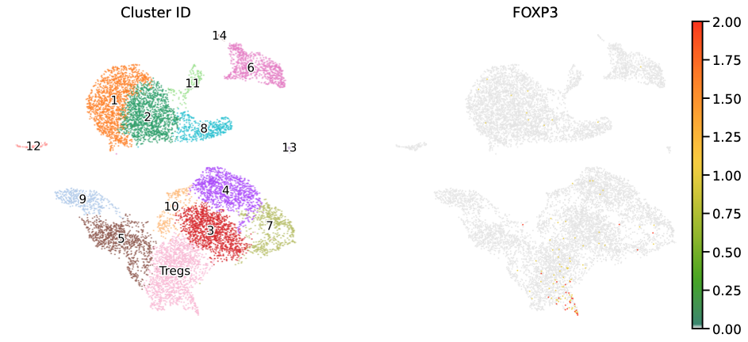
Problem 2
Problem | Name | Mitocondrial content | n_Counts | n_Genes | PC
2 | Graham | 20 | 500 | 500 | 20PC

Slide 4
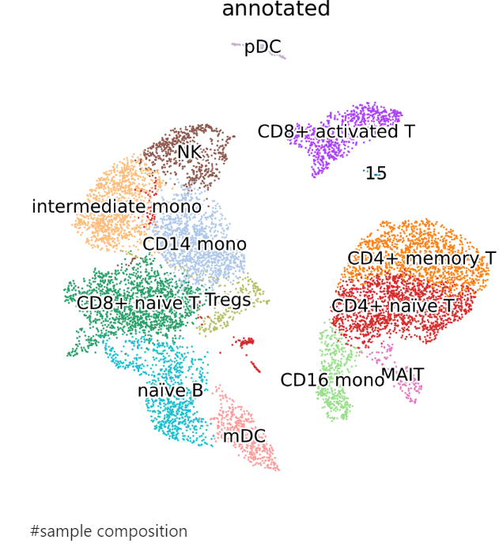
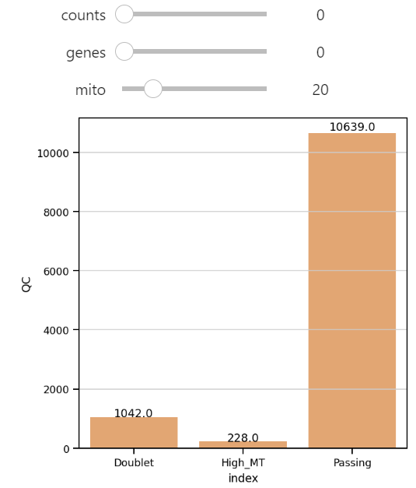
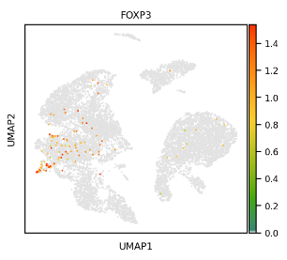
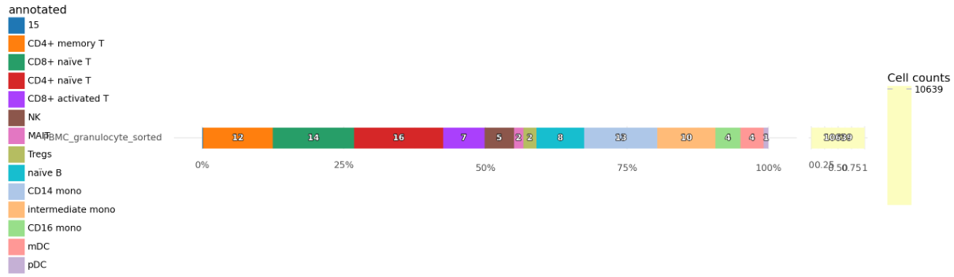
Problem 3 - Manibarathi nPC = 20

Slide 5
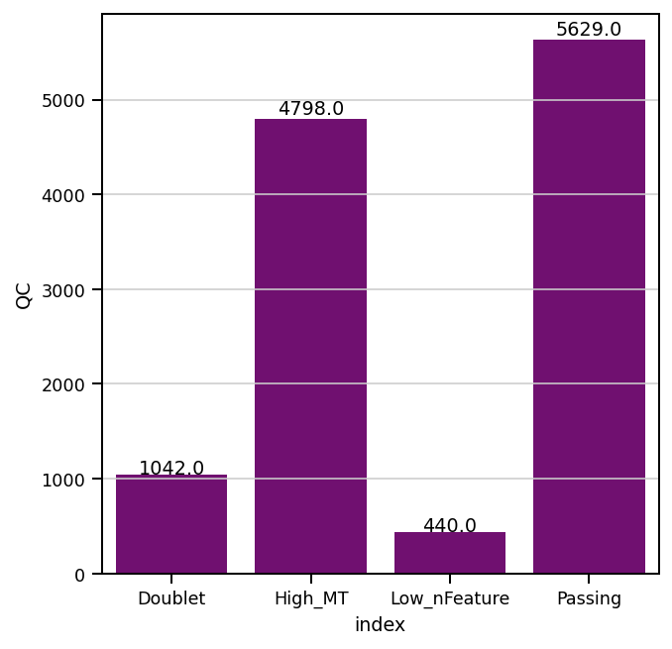
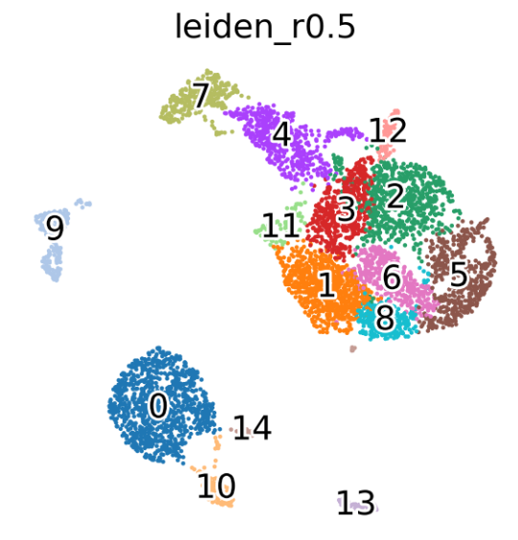
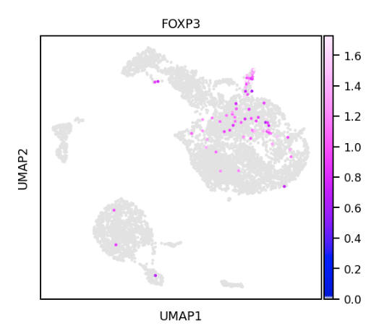
Problem 4 (Ellen - mito 10, counts 1000, genes 1000, PC 20)

Slide 6
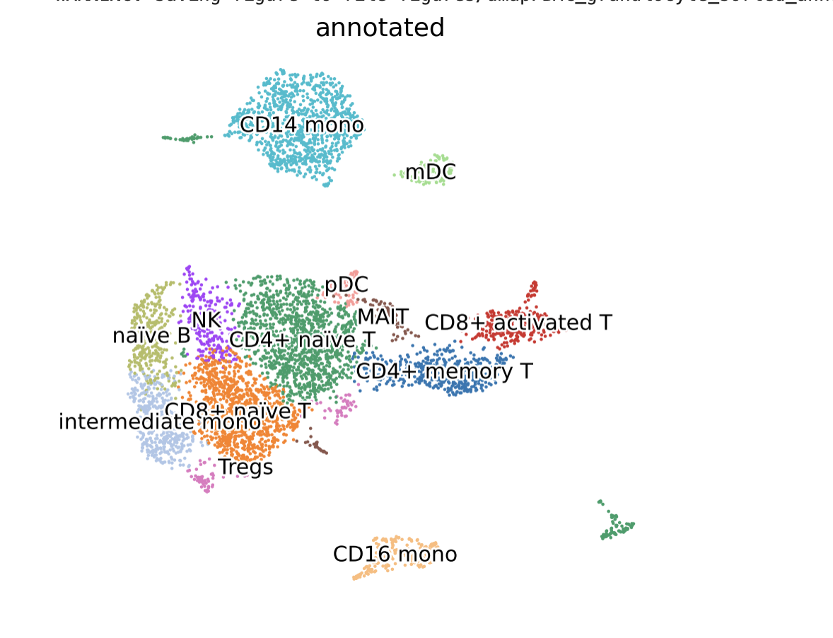
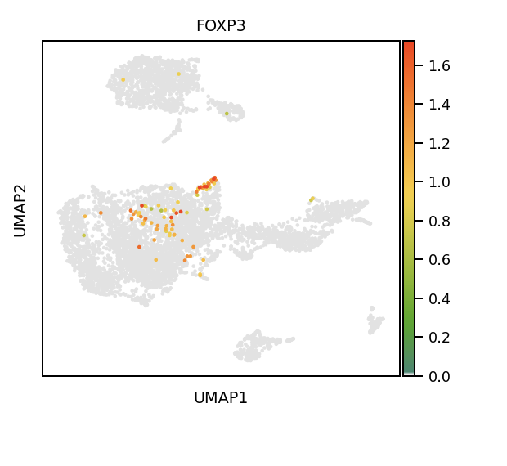
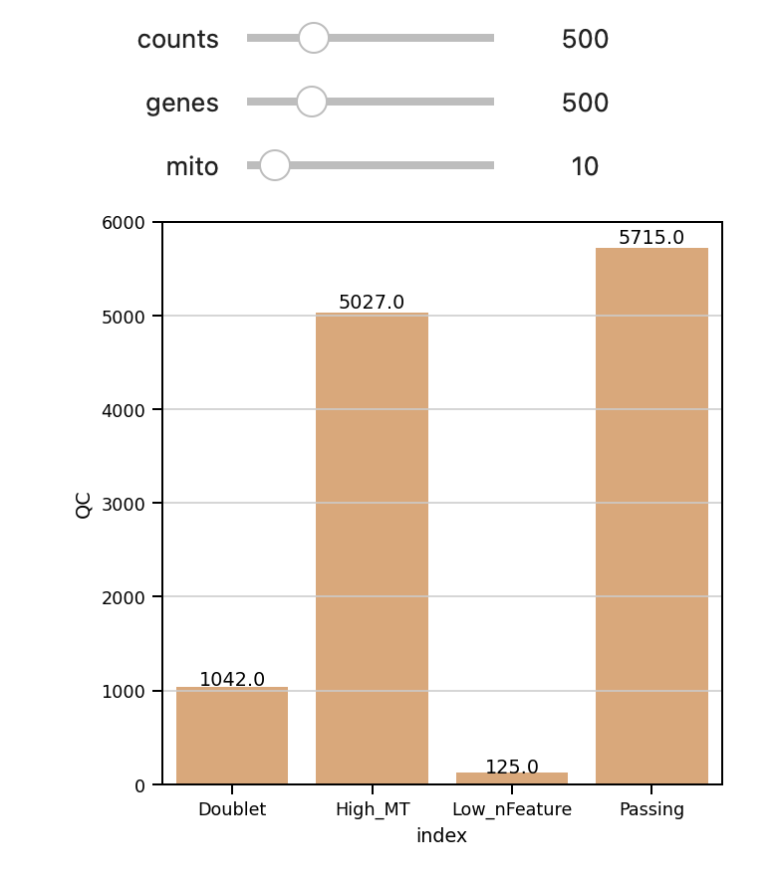
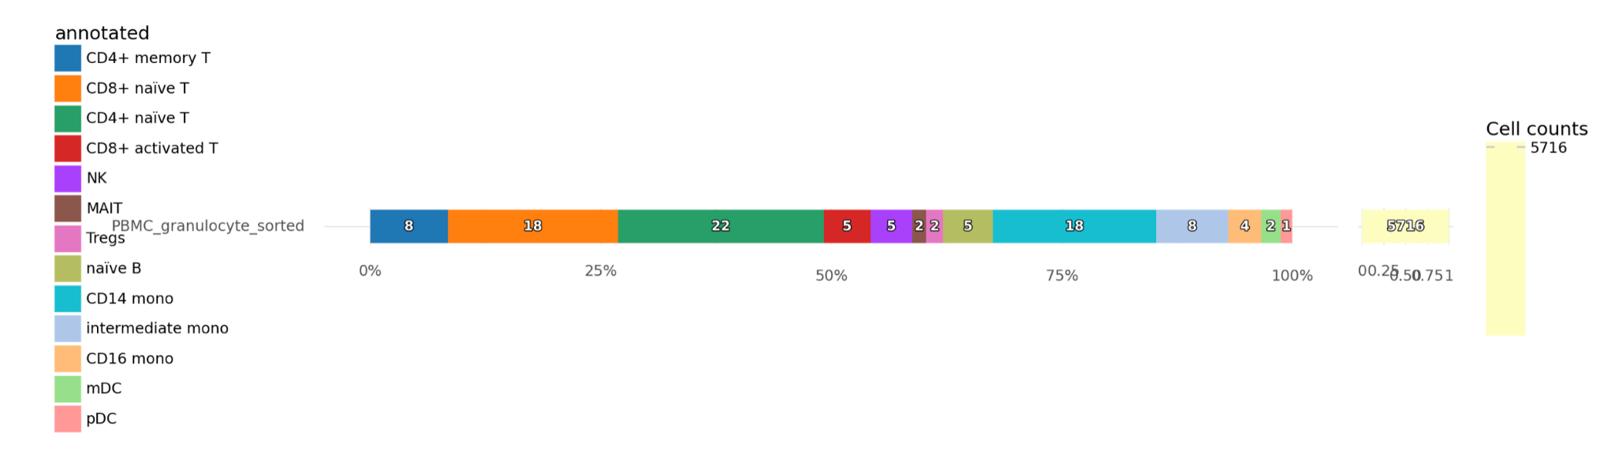
Problem 5 with PC = 20

Slide 7
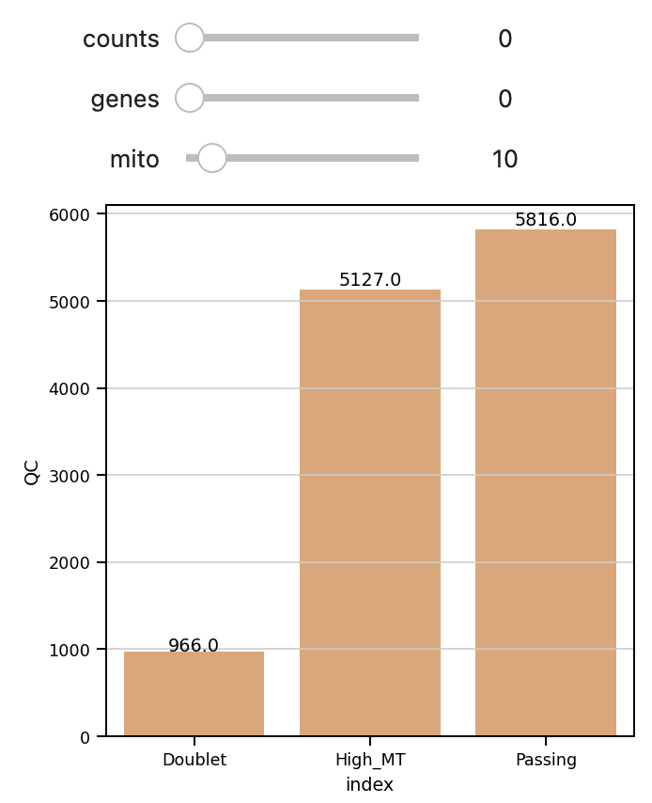
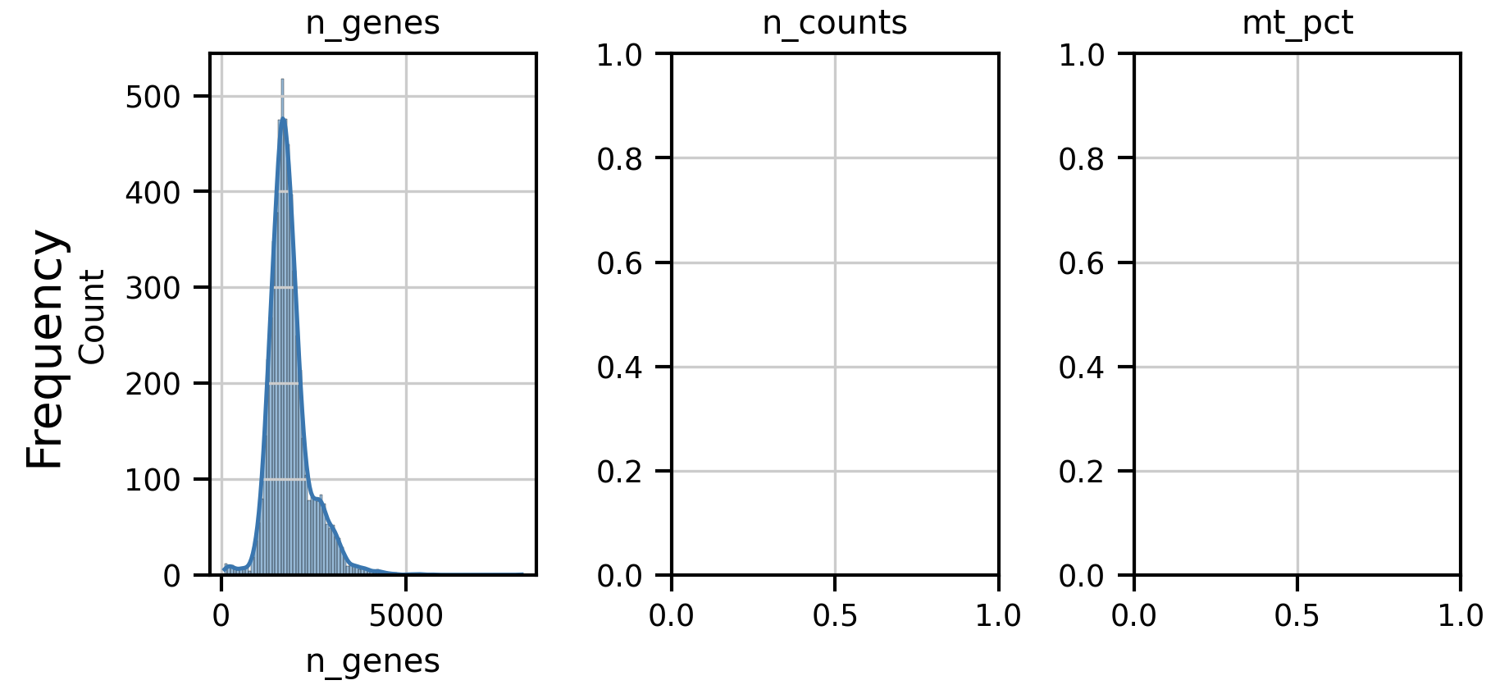
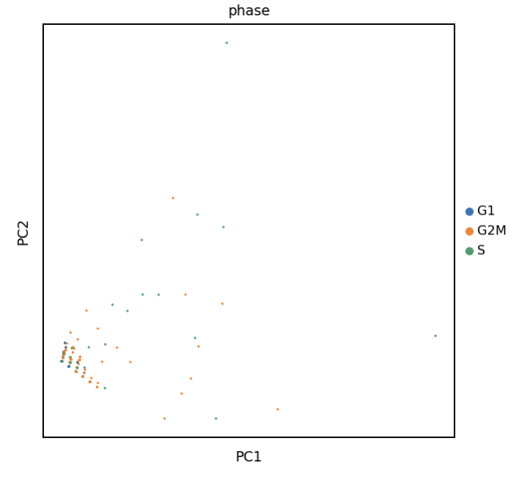
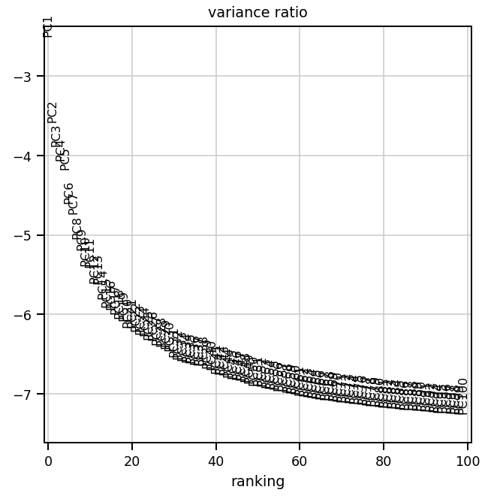
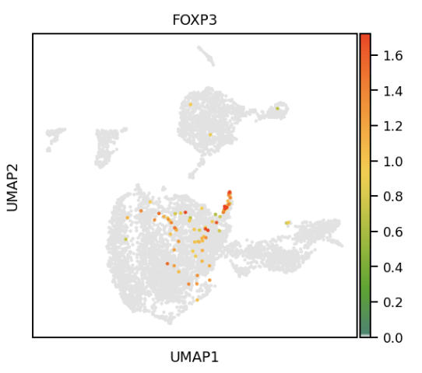
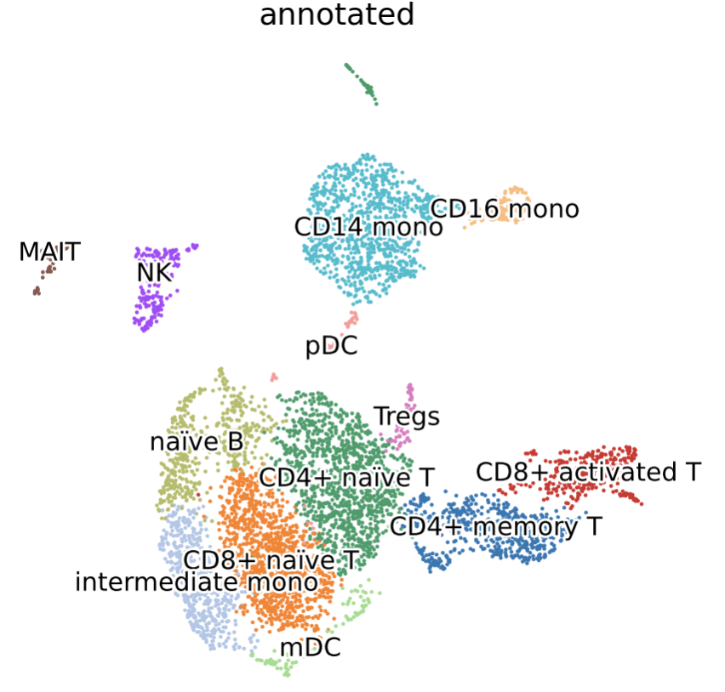
Problem 6 ( mito 10, counts 0, genes 0, PC 20)

Slide 8
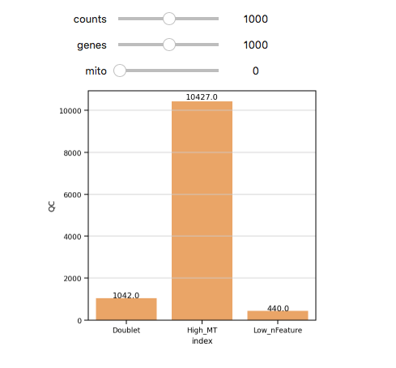
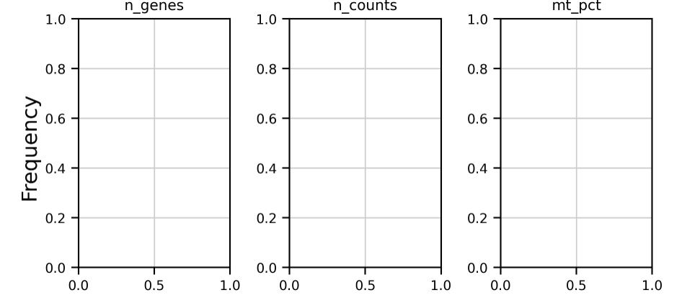
Problem 7: mt=0, counts=1000, genes=1000, 20 PC
Sierra

Slide 9
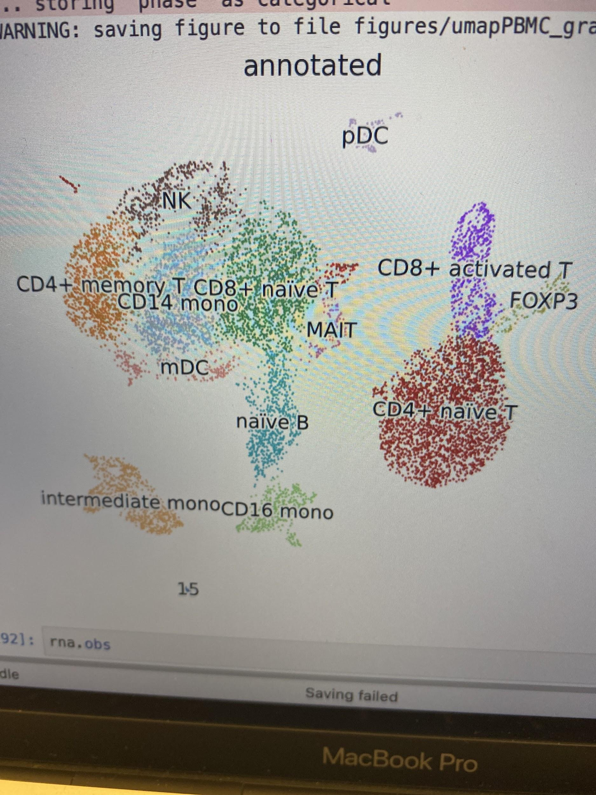
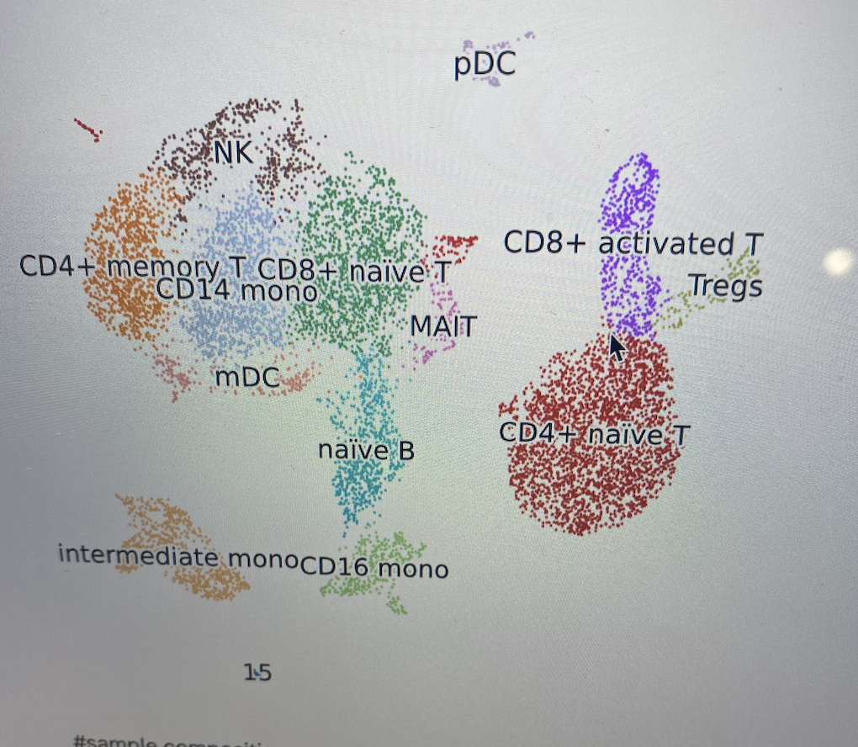
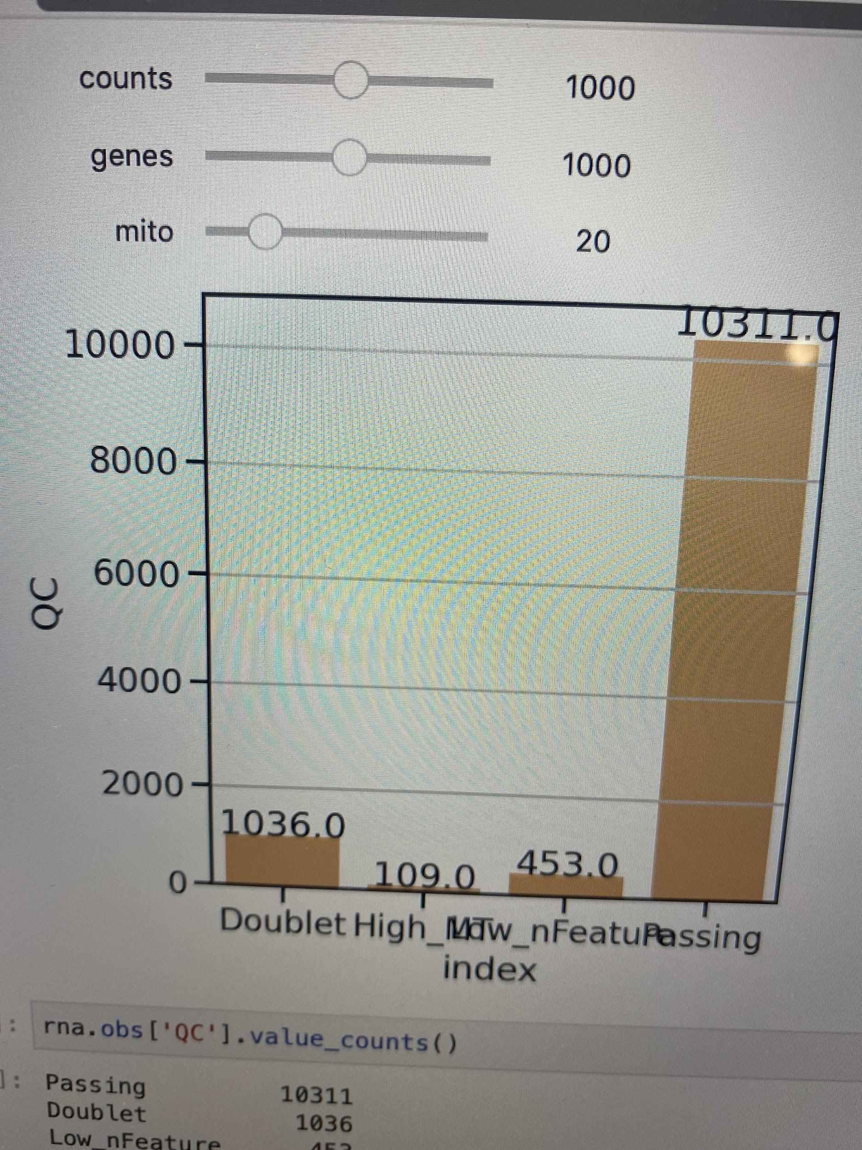
Problem 10: %mito=10, min genes, counts = 1000

Slide 10
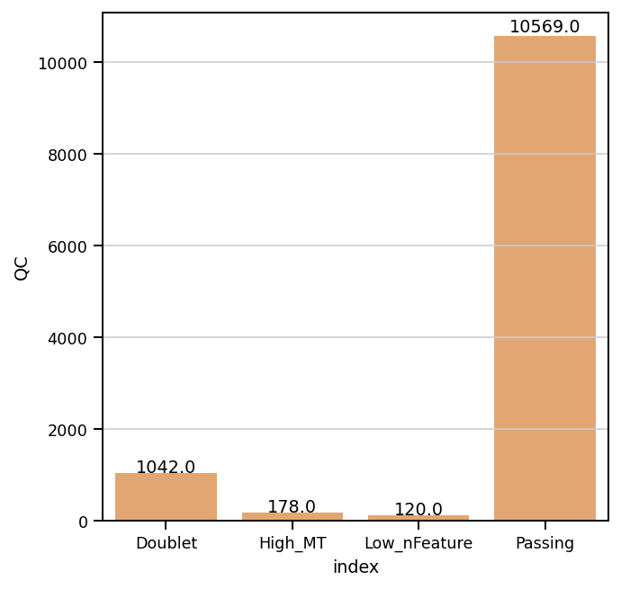
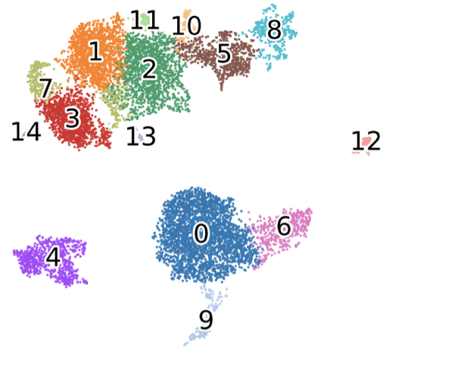
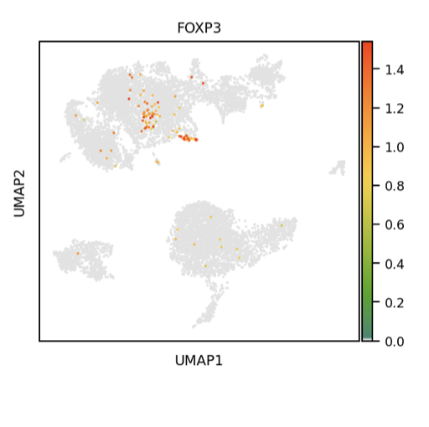
Problem 11- 20 mt/500/500 100PC

Slide 11
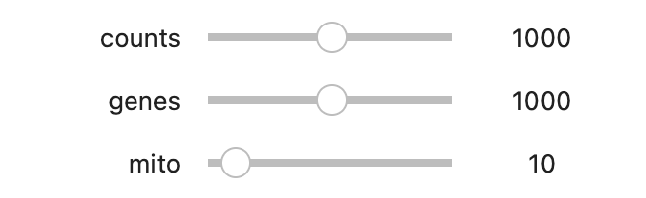
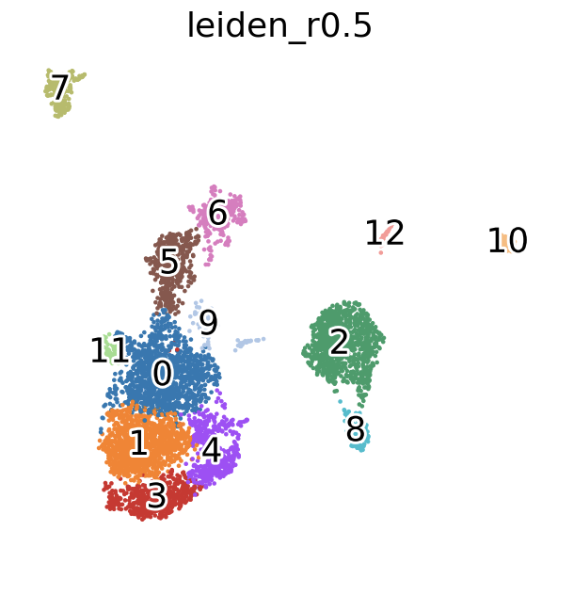
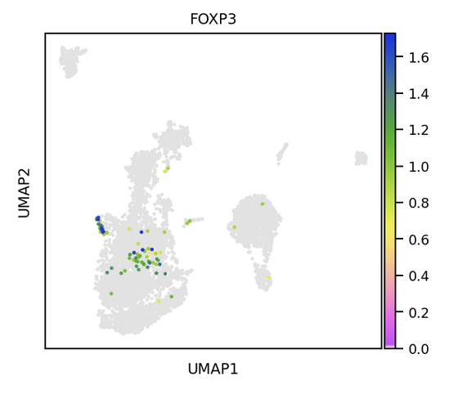
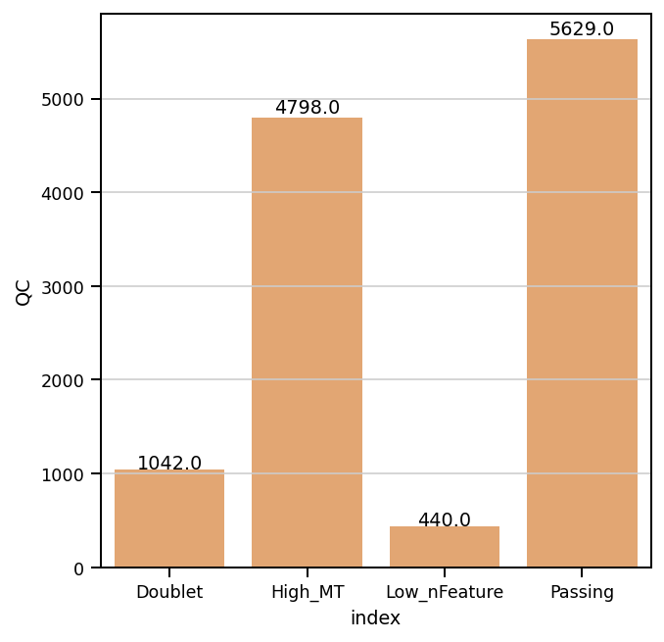
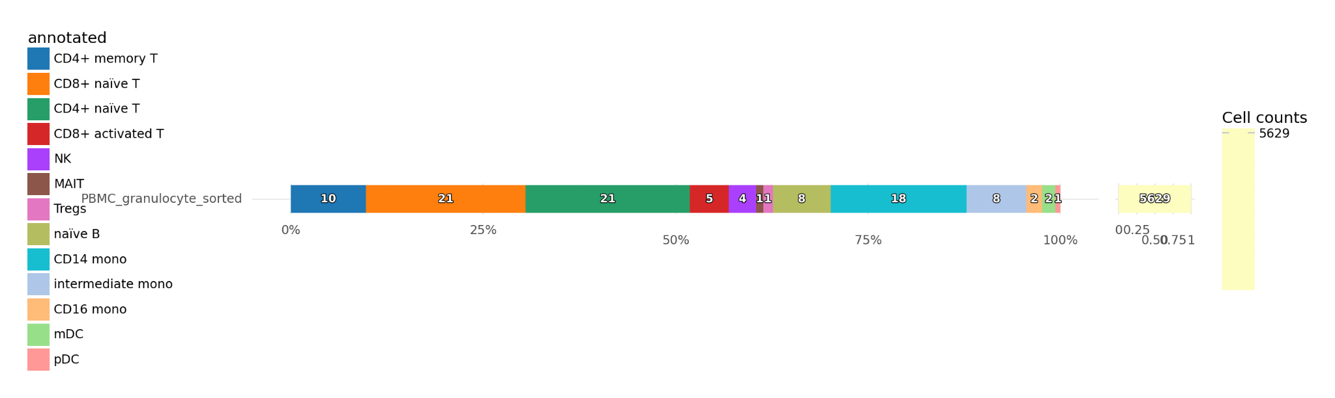
Problem 13: 10/1000/100 100 PC (Simon)

Slide 12
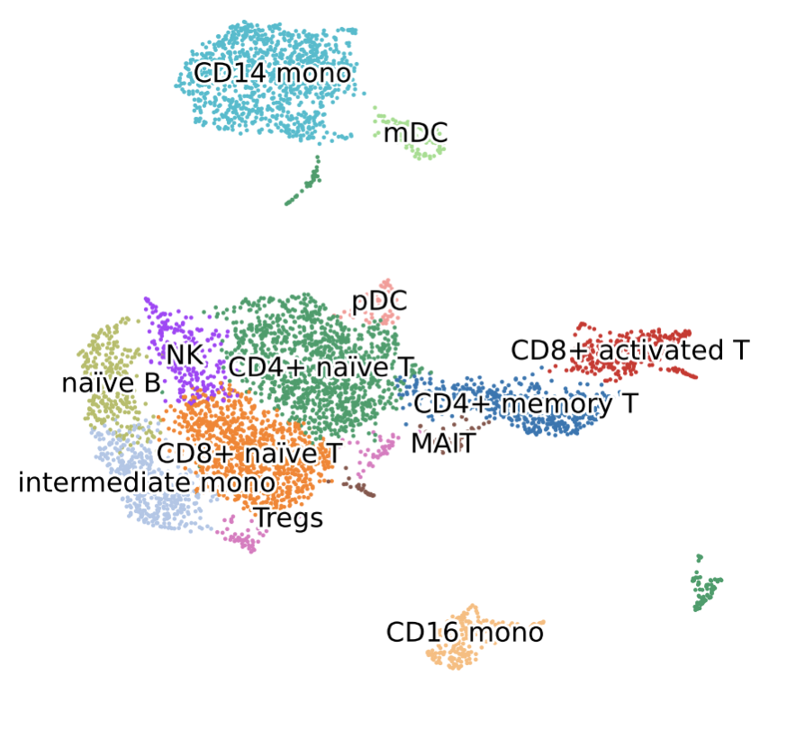
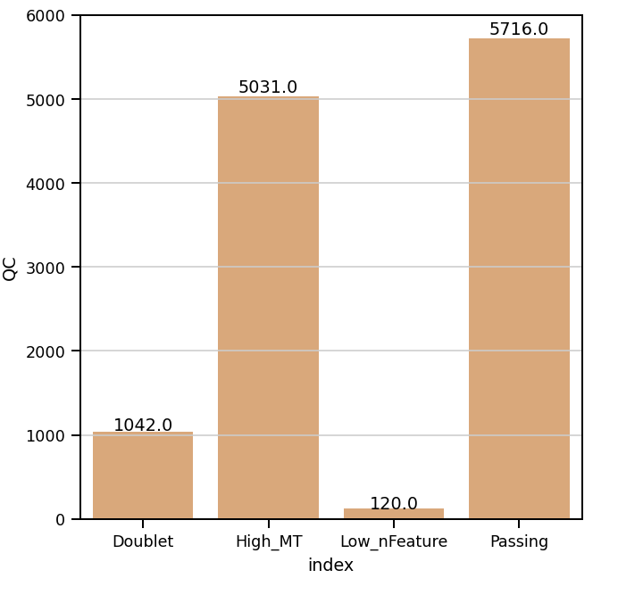
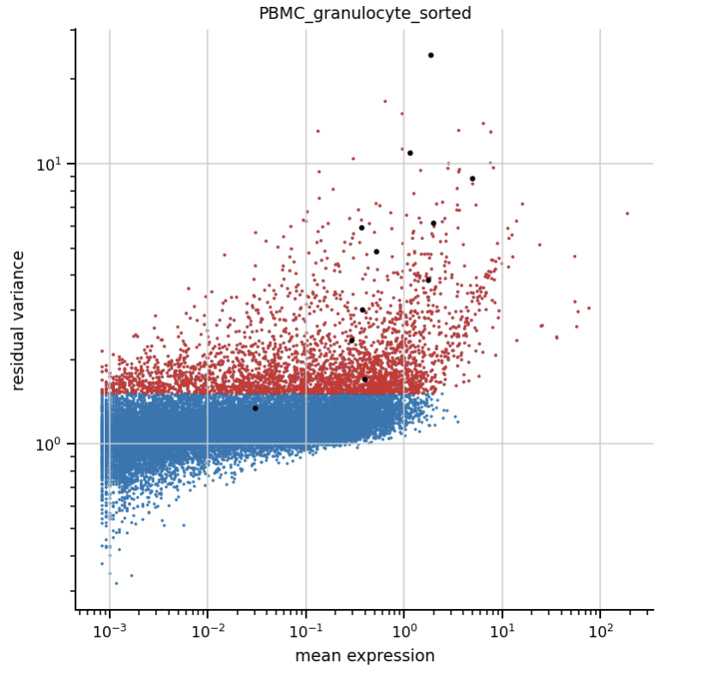
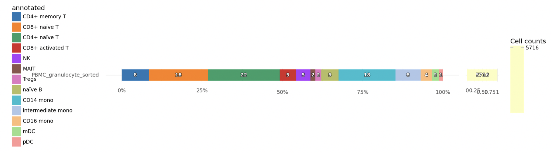
Problem 14

Slide 13
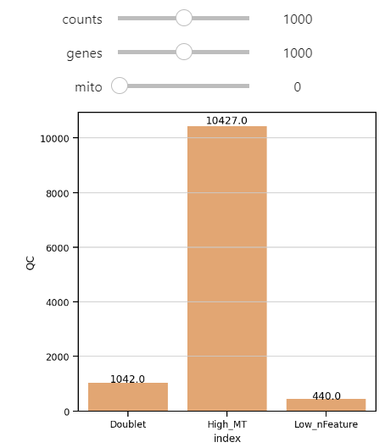
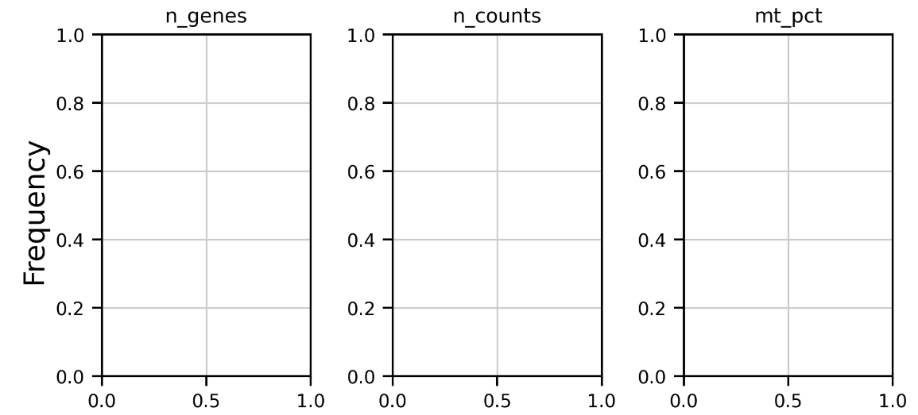
Problem 16_Gautami

Slide 14
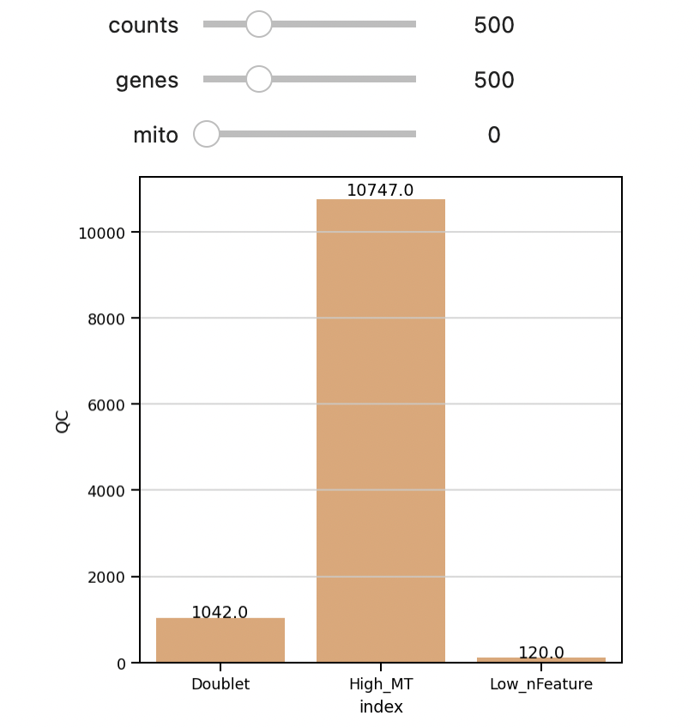
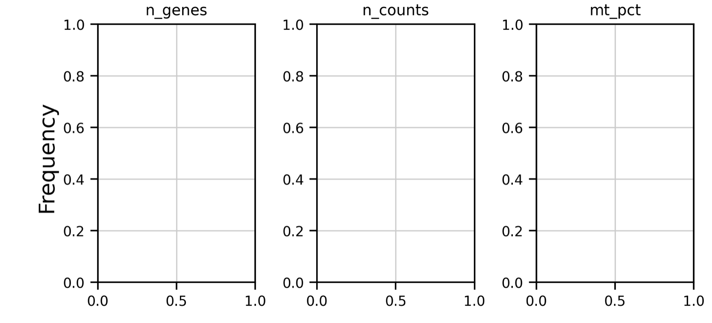
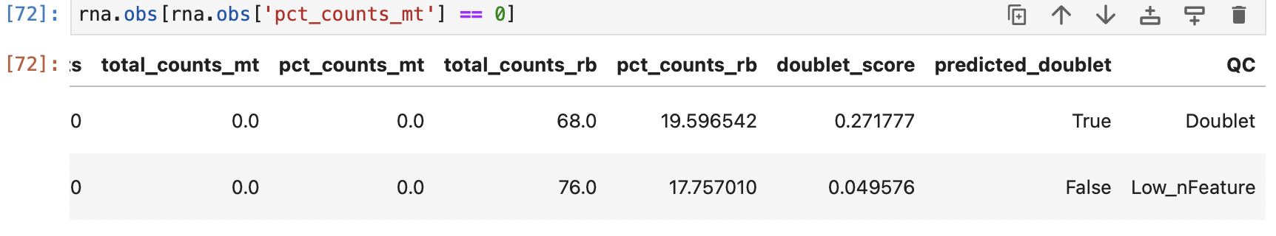
Sheed Problem 17

Slide 15
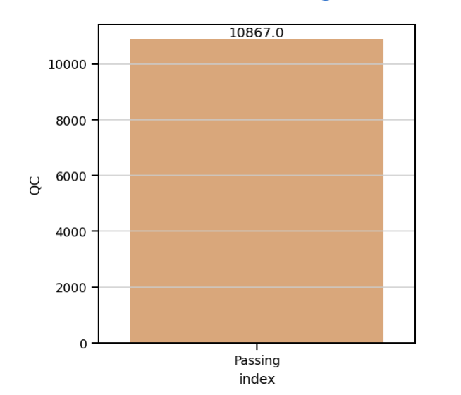
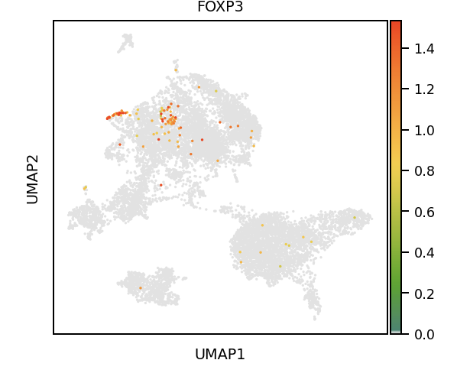
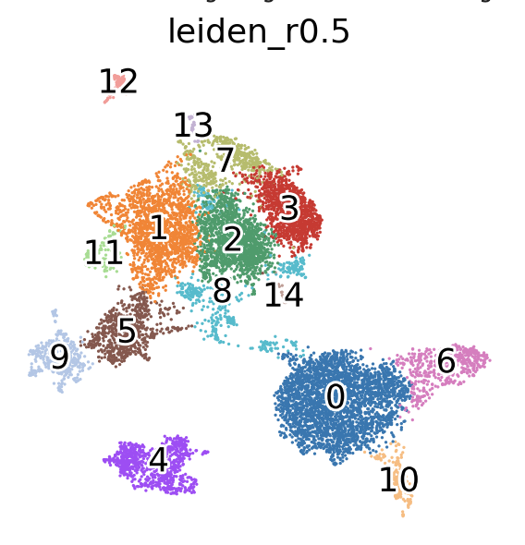
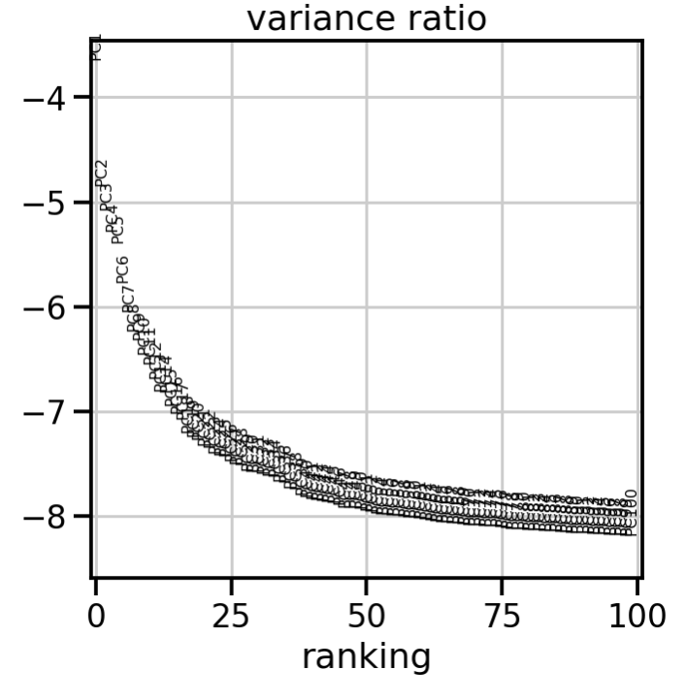
Jared, Problem 18: No filters, 100 PCs

